Slide 1
Unit 6 Linear regression

Slide 2
Objectives
At the end of this lecture, you will be able to do the following:
Understand the goals of regression .
Identify the regression function and know what property of the dependent random variable the regression function is trying to capture as a function of the explanatory variables .
Plot and understand box-and-whisker plots .
Know the linear regression function .
Understand the theoretical and empirical linear regression solutions.
Write the linear regression problem as a noisy linear model .
jeffrey's prior will prefer one parameter value over other, but, that preference is drawn purely based on probability model we are trying to predict, that preference of value does not come from prior "knowledge" additional to modeling assumptions.

Slide 3
Goals of Regression
Let’s consider 2 random variables X and Y. For example,
1. X is the amount of $ spent on FB ads and Y is the total conversion rate
2. X is the age of the person and Y is the number of clicks
Given 2 random variables X, Y, we can ask the following questions:
How to predict Y from X? (model)
Error bars around this prediction ( var(y) )
How much more conversion Y for an additional dollar? (coefficient in regression)
Does the number of clicks even depend on age? (coefficient in regression)
What if X is not a single r.v. but a vector? For example X=(X1, X2) where X1 is the amount of dollars spent on FB ads and X2 is the duration in days of the campaign

Slide 4
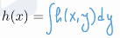
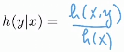
Modelling assumptions in regression
We have 2 iid r.v. X and Y, that have some joint distrib, and joint distribution could tell me that they are independent, or positively/negatively correlated
Regression is really about understand the conditional distribution of y given x
Joint distribution of X and Y can be described by 1) joint PDF 2) marginal density of X and the conditional density
H(y/x) answers all our questions, it contains all the info about y given x
Finding out PDF of y given each possible value of x is a difficult task, instead we settle with some parameter of this distribution (mean, median, quantiles)

Slide 5
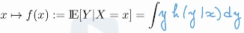
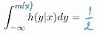
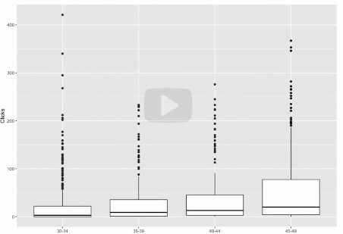
Partial Modeling, Regression Function, and Conditional Quantiles
We can also describe the distribution of y/x partially using
The expectation of Y – E[Y]
The conditional expectation of Y given X=x – E[Y/X=x]
Conditional expectation is what we call the regression function
Other possibilities are 1) conditional median m(x) such that,
Conditional quantiles, conditional variance
50% of observations are in box (between 25% - 75%)
The thick line in the middle is median

Slide 6
Linear Regression: The Function for Conditional Expectation of Y Given a value x
We can’t always find E[Y/X=x] because we do not have data points at each x, so we have to use neighboring values in x
So, when we do linear regression, we are actually getting information from all the points, to estimate the conditional expectation at one point
If our aim is to have f(x) = E[Y/X=x]:
there are too many possible regression functions f (nonparametric)
It is useful to restrict to simple functions that are described by a few parameters
Simplest is f(x)=a+bx – linear function

Slide 7
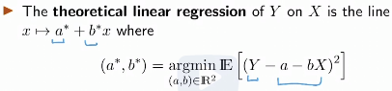
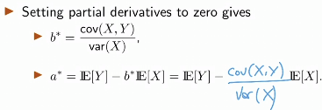
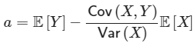
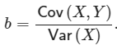
Optimal Theoretical Regression Line
So, we decided to use linear regression line for finding E[Y/X=x]
Then we want to find best linear regression line and we use squared distance as distance metric between true Y’s and fitted Y, and we want them to be as close as possible
So, we want to minimize E[(Y-Y^)^2/X=x]= E[(Y-a –b*X)^2]
We want to find a and b that will minimize this expression
So, we find derivatives wrt to a and b, set them to 0, and find 2nd derivatives and hessian so that we verify the found critical points represent the minimizers not maximizers
In b we see cov/var, so if X and Y are changing in the same direction then we have (+) slope, if opposite directions, then (-) slope

Slide 8
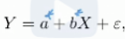
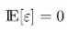
Linear Regression in Practice: Linear Model Plus Noise
Clearly, the points will not lie exactly on the fitted line if var(Y/X=x)>0, we will have some noise eps which equals to so that
Noise eps should satisfy: and
We get this by plugging best fitted a^ and b^ from theoretical LR
So, it is just a property of linear least squares method

Slide 9
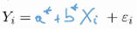
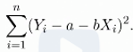
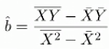
Empirical Linear Regression via The Statistical Hammer
In practice a* and b* are needed to be estimated from data
So, given X1,Y1 … Xn, Yn n pair points we should have
In this setting, we need to estimate a* and b*
Definition of LSE (least squares estimator) of (a,b) is the minimizer of the sum of squared errors where for a and b we have

Slide 10
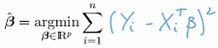
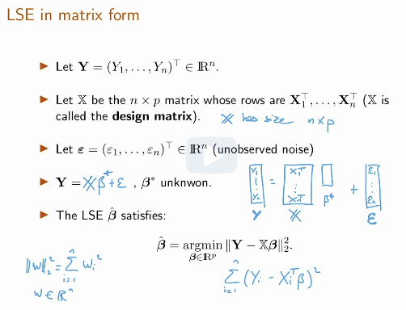
Multivariate Regression: Definitions, Modeling, and Matrix LSE
In multivariate case we have more than 1 Xi, that is X is in Rp; our model:
Here X (expl variables), beta (coeff), eps (error terms) and Y (response var) all are vectors
1st term of X vector is 1, as this corresponds to multiplication with intercept
Again E[eps]=0 and cov(Xi,ei)=0 (this time vectors)

Slide 11
Multivariate Linear Regression
At the end of this lecture, you will be able to
Write down the multivariate linear regression model .
Compute the distribution of the least square estimator (LSE) for linear regression with deterministic design .
Know that in the setting of deterministic design, the least square estimator is the maximum likelihood estimator.
Compute the quadratic risk and prediction error of the LSE.
Perform hypothesis test for linear regression models.
Design Bonferroni's tests for testing multiple hypotheses.

Slide 12
Linear independence and span
Linear independence
Vectors v1,…,vn are said to be linearly dependent if there exist scalars c1,…, cn such that not all ci’s are 0 and
Vectors that are not linearly dependent are said to be linearly independent
In other words, vectors v1,…,vn are linearly independent if the only scalars c1…cn such that
2 non-zero vectors v1, v2 are linearly dependent if and only if v1=c*v2
Span
Linear span of a set S of vectors in a vector space is the smallest linear subspace that contains the set

Slide 13
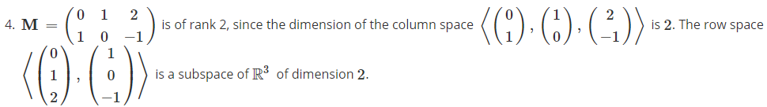
Rank
The column and row space of matrix is the subspace spanned by its columns and its rows respectively
It is a fact from linear algebra that the dimension of the column space of a matrix M is equal to the dimension of its row space
This dimension is the rank of the matrix, denoted by rank(M) and =rank(M’)
So span is a subspace, whereas rank is the dimension of subspace

Slide 14
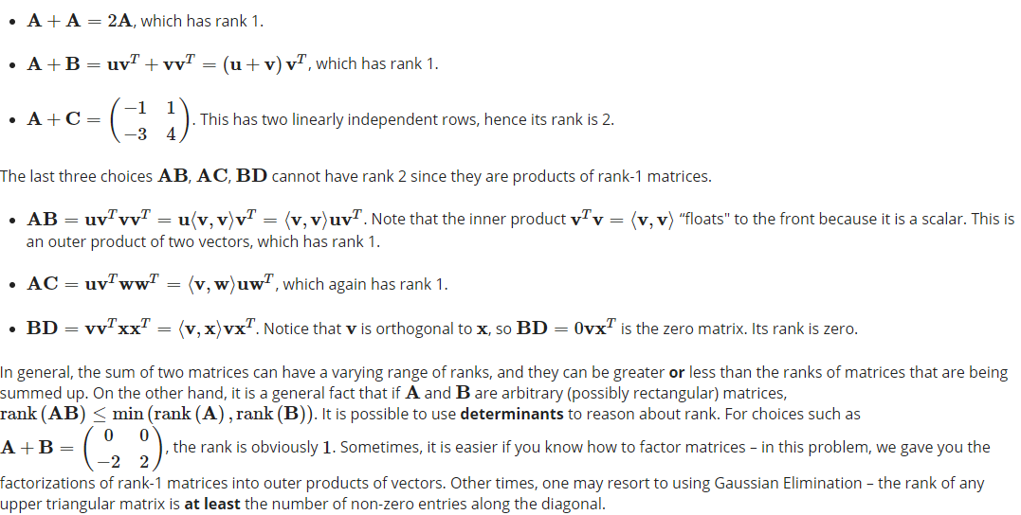
Rank examples
In general, the sum of 2 matrices can have varying range of ranks, and they can be greater or less than the ranks of matrices that are being summed up
On the other hand, it is a general fact that if A and B are arbitrary matrices, rank (AB) < min(rank(A), rank(B))

Slide 15
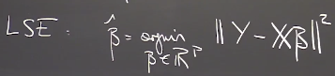
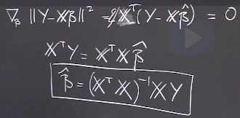
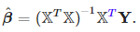
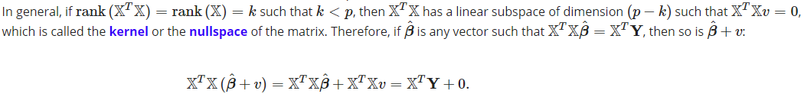
Multivariate Linear Regression
The way we do matrix calculus is to work as with scalar valued functions, but consider the dimensions of the vectors
Given multivariate setting, our goal is again is to estimate parameters of beta vector that minimize the squared misfit
We take derivative wrt to each b and equate to 0 and then
We get system of linear equations for each beta
To solve this equation we invert it so that we get beta vector
Now, it is important that matrix X’X should be invertible
X’X is p*p matrix and it should have rank p to be invertible (so n>=p)
When p>n this is high-dimensional statistics

Slide 16
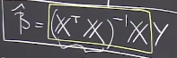
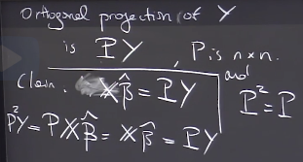
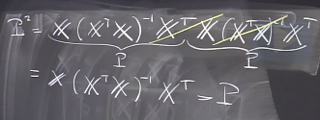
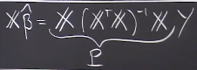

Geometric Interpretation of Linear Regression
Beta is linear in Y
X’*beta is linear combination of rows of X
Which is subspace, and when we fit beta’s we want to find hyperplane so that distance between hyperplane and Y’s are minimized
Y’s that are on fitted line correspond to orthogonal projections of Ys onto hyperplane
For projection matrix we have P^2=P
So we project Y’s to column space of X’s

Slide 17
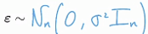
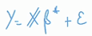
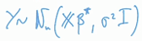
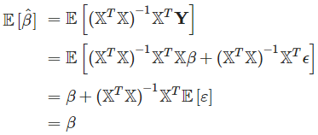
Linear Regression with Deterministic Design
If var(eps) increases with x, then it is probably not due to noise alone
In deterministic design for LR, we assume that the design matrix X is deterministic instead of random, the model still is random vector, representing noise, so the only random thing is eps
Deterministic setting is like we designed a sequence of x’s, measured corresponding y’s and had associated random error with each measurement which has mean 0 and constant variance
To make an inference (confidence regions, tests), we need more assumptions
1) The design matrix X is deterministic and rank(X)=p
2) The model is homoscedastic: errors are iid and var(ei)=const
3) The noise vector eps is Gaussian so for Y we have
Sequence (or a vector) of random variables is homoscedastic if all its
random variables have the same finite variance. -homogeneity of variance

Slide 18
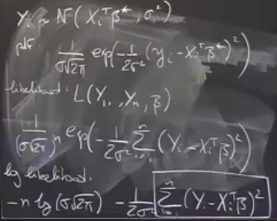
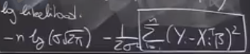
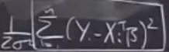
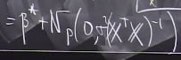
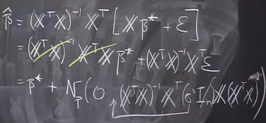
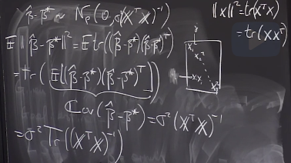
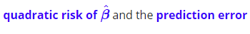
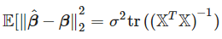
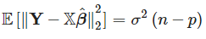
The Least Square Estimator is the MLE in Deterministic Design
When we assumed eps to be , Y, which is equal to will also have normal distribution and when finding its MLE we will have:
By writing out log likelihood we see that we need to
Maximize which is the same as
Minimizing which is LSE
So, if we assume Gaussian noise, LSE=MLE
Now, we are interested in distribution of beta^
Quadratic risk

Slide 19
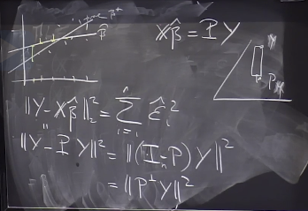
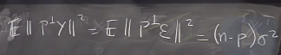
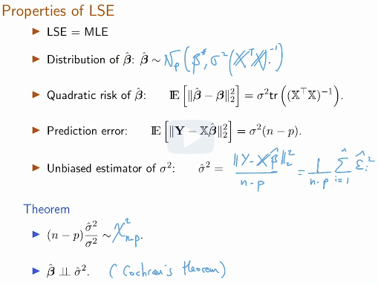
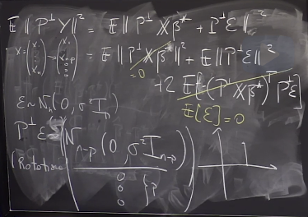
Prediction error
a

Slide 20
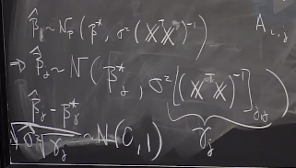
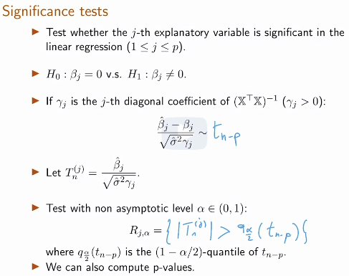
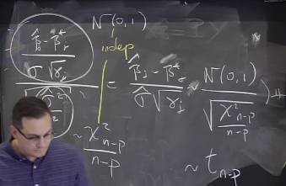
Significance Tests
Now, that we have distribution of beta^, we can perform tests on it
Here, by testing specific beta_j, we can see whether the variable xj has any impact on prediction
To do hypothesis test on beta^, we need to normalize it
Mean and divide by std (as we do not know sigma^2, we
Plug its unbiased estimator instead, we get t( student’s t
Distribution (N/sqrt(Chi))

Slide 21
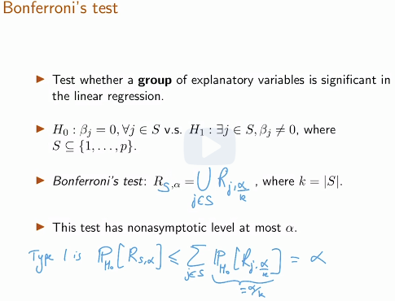
Bonferroni's Test and Remarks
If we do hypothesis test for several betas at the same time and considering they are independent, and all for the same level alpha, by chance we may reject H0
To make this analysis correct we need to reduce quantiles, so that it considers the number of variables in the test, so that it reduces critical values when number of variables tested increases
So, we have to remember to do Bonferroni correction or some sort of correction if we are doing bunch of tests simultaneously (but Bonferroni makes test more conservative)
Statistical hypothesis testing is based on rejecting the null
hypothesis if the likelihood of the observed data under the null
hypotheses is low. If multiple hypotheses are tested, the chance
of observing a rare event increases, and therefore, the likelihood
of incorrectly rejecting a null hypot (i.e., a type 1 error rate) incr
The Bonferroni correction compensates for that increase by
Testing each individual hypothesis at a significance level of a/m,
where a is a desired overall alpha level and m is the number of hypotheses

Slide 22
Remarks
Linear regression exhibits correlations, not causality
Normality of the noise: One can use goodness of fit tests to test whether the residuals are Gaussian or not (e.g. Kolgomorov-Smirnov)
Deterministic design: If X is not deterministic, all the above can be understood conditionally on X, if the noise is assumed to be Gaussian, conditionally on X

Slide 23
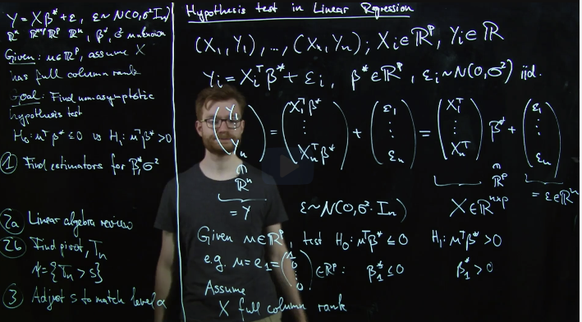
Recitation 23. Hypothesis test for linear regression
We want to do hypothesis test on beta* (vector), we can do different tests based our wish, for example if we set u=[1,0…0] then we can test H1: u’b>0 vs H0: u’b<=0
We assume Gaussian
Noise
Set up for recitation is:
1) Find estimators for beta*
And sigma^2 (var of eps)
2) Find pivot stats Tn, Tn>s
3) Adjust s to match level s

Slide 24
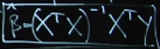
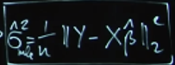

Recitation 23. Hypothesis test for linear regression
Here we find estimators for beta and sigma^2 using MLE

Slide 25

Recitation 23.Hypothesis test for linear regression(Linear algebra review)
In mathematics, particularly linear algebra, a spectral theorem is a result about when a linear operator or matrix can be diagonalized (that is, represented as a diagonal matrix in some basis). This is extremely useful because computations involving a diagonalizable matrix can often be reduced to much simpler computations involving the corresponding diagonal matrix.
Orthogonal vectors are vectors whose
Dot product=0, orthonormal on top of
That should have length 1
If we multiply a vector by orthonormal
Matrix and find its norm^2, it will be
Same as norm^2 before multiplication
With a vector
Symmetric square matrix of m*m can
Be decomposed into product of
V (orhtog matrix) and diag matrix

Slide 26

Recitation 23. Hypothesis test for linear regression (LR review)
Projections matrices have property H’=H; H^2=H, all eigenvalues are either 1 or 0
Tr(A)=sum of its diagonal elements; if we construct a square m*m matrix as a product of 3 matrices we can swop the order of multiplication
If we decompose a symmetric matrix A
Into its eigenvector, diag and eigenvalue vec
We get trace(A)=sum of its eigenvalues

Slide 27







Recitation 23. Hypothesis test for linear regression
Now, we examine the distribution of our test statistics using linear algebra concepts reviewed earlier
If we centralize it, it has distribution, but we don’t now know sigma^2, so that we divide by it, so we analyze its estimator
it turns out to be
Now we analyze H
And we decompose it using SVD
And we get H=

Slide 28








Recitation 23. Hypothesis test for linear regression
We continue with the analysis of distribution of var(eps), we found that
So we continue with
Having found we
Insert it to
Then we analyze the distrib of var
Again which turns out to
And find its mean and variance
And we have
Having found this we need to verify
That var and numerator in Tn are
Indep, so we find cov=0

Slide 29


Recitation 23. Hypothesis test for linear regression
Here, we normalize Tn so
That it has mean 0 and variance 1
However, as we use sample var
Instead of population variance we
Get t-distribution instead of normal
Distribution
Critical values correspond to
Critical values of t distribution

Slide 30



Recitation 24. Multiple Hypothesis Testing and the Bonferroni Correction
We consider the homoscedastic linear model where is deterministic
Of rank p, and . We want to test
When we have multiple hypothesis test each with level alpha, if we test separately then for 2 tests together we do not have the
Same alpha, but alpha1+alpha2, if
Those hypothesis are mutually exclus
To compensate for multiple hypot,
So that together they have at max
Error rate of alpha, we need to set
Different individual critical values,
Precisely alpha/k, where k is the
Number of different hypotheses

Slide 31


Recitation 24. Multiple Hypothesis Testing and the Bonferroni Correction
Here, we write down our 1st hypothesis test
We write down distribution of beta1, normalize it and find critical value

Slide 32


Recitation 24. Multiple Hypothesis Testing and the Bonferroni Correction
Here, we write down our 2nd hypothesis test
We write down distribution of beta2-beta1, normalize it and find its critical value
In final recitation, we overview what we done

Slide 33




Recitation 25. Ridge regression
We specify the LR model for both Yi (one y) and vector Y
We want to compare quadratic risk of an estimate for beta:
We compare quadratic risks for frequentist (one true beta) vs Bayesian estimates (beta is r.v.)
By specifying prior for b
And calculating posterior
Using observations Y
We will use mean of
Bayesian estimator
Our prior for beta is
Normal distribution

Slide 34

Recitation 25. Ridge regression
We write down equation for posterior distribution and plug in prior and likelihood
By analysing the final product we find out mean and cov matrix of posterior which has normal distribution

Slide 35

Recitation 25. Ridge regression
So, it turns out that beta using least squares approach with regularization is the same as MAP and mean estimator using Bayesian approach when prior distribution of beta is assumed to be Gaussian
Regularized estimator for linear regression is called ridge estimator

Slide 36

Recitation 25. Ridge regression
We assume that p=n, X’X=I and calculate the quadratic risk for linear regression with regularization
Our estimator turns out to be biased, but we aim to reduce overall quadratic risk by aiming to reduce the
variance

Slide 37

Recitation 25. Ridge regression
Here we calculate the value of lambda that minimizes the quadratic risk

Slide 38

Recitation 25. Ridge regression
Some remarks
We obtained an estimator that is useful in a frequentist setup through Bayes calculation
Estimator found using LR with regularization (Ridge regression) with optimal choice of lambda is not a proper estimator, as lambda depends on true beta
However, we can use cross validation or some other approaches
Ridge regression (regularized) is useful when p>n, X is rank deficient, more variables than data points

Slide 39




Insight from exercises
When we have n iid Gaussian X’s, while calculating likelihood, we multiply all f’s together as they are independent
When Gaussian X’s are not independent, we use multivariable gaussian distribution, and there is no need to multiply it n times, as it both incorporates all n X’s, and there is no independence so that we can multiply
(A+BC)’=A’+(BC)’=A’+C’B’; transpose of scalar is itself

